Slide 1

DEPARTMENT OF COMPUTER SCIENCE & ENGINEERING SCHOOL OF COMPUTING
1156CS601- MINOR PROJECT WINTER SEMESTER(20-21)
REVIEW - I
“AI based tracking system from real time CCTV captures”
SUPERVISED BY
PRESENTED BY
Dr. N. MALARVIZHI
Professor
Arun Kumar Dash (VTU 11182)(18UECS0974)
Dhanush Hegde (VTU 11158)(18UECS0226)
R. J. Naveen Kumar (VTU 11247)(18UECN0011)
1

Slide 2


AGENDA
ABSTRACT
OBJECTIVE
INTRODUCTION
LITERATURE REVIEW
DESIGN AND METHODOLOGIES
IMPLEMENTATION
CONCLUSION
REFERENCES

Slide 3

Every day, there are a minimum of 50 suspects and numerous identified criminals who are roaming freely in the public. The objective of this project is to help Police and higher authorities to track down missing people and wanted criminals quickly. The usual process to track a person is using investigation which requires time and experience to ask right questions. Most of the time, investigation method works pretty well but it is time consuming and can be unsuccessful if the missing person missing has been shifted/moved to different location (city/country). In such cases, the ideal approach is to go through CCTV footages and evidences. Again, this can be very time consuming and given the number of people that go missing every day, it can be a challenge to keep up with it. Hence an AI based tracking system will be developed through which the wanted criminals can be tracked real-time along with the missing people and will alert the police with the location wherever they are located.

Slide 4

Aim of the Project:
To build a system which identifies missing people/wanted criminals over the real-time CCTV captured data.
Scope of the Project:
To detect the location of missing people / wanted criminals.
To construct an alerting system to identify any illegal items are publicly carried by people such as weapons.

Slide 5
An average of 200 Children go missing in India every day. Girls made up 52,049 missing cases in 2019 while boys accounted for 21,074 cases. It has also been reported that 15 transgender children went missing in 2019.
Every day, there are a minimum of 50 suspects and numerous identified criminals who are roaming freely in the public.
To avoid this situation, we introduce an AI based tracking system through which the wanted criminals along with the missing people can be tracked real-time and the police will be alerted with the location wherever they are located.
As the traditional method is to search for him in the streets manually, this method will decrease the time taken for such cases.

Slide 6
Ayyappan, S., and S. Matilda. "Criminals And Missing Children Identification Using Face Recognition And Web Scrapping." In 2020 International Conference on System, Computation, Automation and Networking (ICSCAN), pp. 1-5. IEEE, 2020.
This paper scraps images from social media websites and recognizes faces from the dataset of criminals and missing children using HAAR cascade classifier. It creates a unique template for each face and compare them with other images available in dataset. If the match is found for the input face, then the details associated with the related image will be displayed.
Son, Ngo Tung, Bui Ngoc Anh, Tran Quy Ban, Le Phuong Chi, Bui Dinh Chien, Duong Xuan Hoa, Le Van Thanh, Tran Quang Huy, Le Dinh Duy, and Muhammad Hassan Raza Khan. "Implementing cctv-based attendance taking support system using deep face recognition: A case study at fpt polytechnic college." Symmetry 12, no. 2 (2020): 307.
This paper shows how we design, implement, and conduct the empirical comparisons of machine learning open libraries in building attendance taking (AT) support systems using indoor security cameras called ATSS.

Slide 7
Jose, Edwin, M. Greeshma, Mithun TP Haridas, and M. H. Supriya. "Face recognition based surveillance system using facenet and mtcnn on jetson tx2." In 2019 5th International Conference on Advanced Computing & Communication Systems (ICACCS), pp. 608-613. IEEE, 2019.
This paper presents the implementation of an intelligent multicamera Face Recognition based surveillance system using FaceNet and MTCNN algorithm on Jetson TX2. The proposed portable system tracks the subject or the suspect with the camera ID/location together with the timestamp and logs his presence in the database, using multiple camera installation.
Shirsat, Samit, Aakash Naik, Darshan Tamse, Jaysingh Yadav, Pratiksha Shetgaonkar, and Shailendra Aswale. "Proposed System for Criminal Detection and Recognition on CCTV Data Using Cloud and Machine Learning." In 2019 International Conference on Vision Towards Emerging Trends in Communication and Networking (ViTECoN), pp. 1-6. IEEE, 2019.
This paper proposes Criminal Detection & Recognition using Cloud Computing and Machine Learning. This research paper proposes to use Microsoft Azure Cognitive services and Cloud system for implementation of the proposed system

Slide 8
Papaioannou, Savvas, Andrew Markham, and Niki Trigoni. "Tracking people in highly dynamic industrial environments." IEEE Transactions on mobile computing 16, no. 8 (2016): 2351-2365.
This paper leverages the existing CCTV camera infrastructure found in many industrial settings along with radio and inertial sensors within each worker’s mobile phone to accurately track multiple people.
Yang, Min-Chun, Chia-Po Wei, Yi-Ren Yeh, and Yu-Chiang Frank Wang. "Recognition at a long distance: Very low resolution face recognition and hallucination." In 2015 International Conference on Biometrics (ICB), pp. 237-242. IEEE, 2015.
This project is able to synthesize its person-specific HR version with recognition guarantees. In our experiments, we consider two different face image datasets(HR & VLR). Empirical results will support the use of our approach for both VLR face recognition.
(HR – High Resolution, VLR – Very Low Resolution)

Slide 9
Klontz, Joshua C., and Anil K. Jain. "A case study of automated face recognition: The boston marathon bombings suspects." Computer 46, no. 11 (2013): 91-94.
This case study deals with the problems which would occur when face recognition technology for criminal tracking is used. The suspects have a change in their faces when they grow older and it becomes harder for the technology to track the criminals over the cameras.
Wong, Yongkang, Shaokang Chen, Sandra Mau, Conrad Sanderson, and Brian C. Lovell. "Patch-based probabilistic image quality assessment for face selection and improved video-based face recognition." In CVPR 2011 WORKSHOPS, pp. 74-81. IEEE, 2011.
This project proposes an efficient patch-based face image quality assessment algorithm which quantifies the similarity of a face image to a probabilistic face model, representing an ‘ideal’ face. Image characteristics that affect recognition are taken into account, including variations in geometric alignment (shift, rotation and scale), sharpness, head pose and cast shadows.

Slide 10
Jain, Anil K., Brendan Klare, and Unsang Park. "Face recognition: Some challenges in forensics." In 2011 IEEE International Conference on Automatic Face & Gesture Recognition (FG), pp. 726-733. IEEE, 2011.
This paper discusses recent developments in automated face recognition that impact the forensic face recognition community. Improvements in forensic face recognition through research in facial aging, facial marks, forensic sketch recognition, face recognition in video, near infrared face recognition, and use of soft biometrics are discussed.
Han, Mei, Amit Sethi, Wei Hua, and Yihong Gong. "A detection-based multiple object tracking method." In 2004 International Conference on Image Processing, 2004. ICIP'04., vol. 5, pp. 3065-3068. IEEE, 2004.
This paper describes a method for tracking multiple objects whose number is unknown and varies during tracking. While the image-based object detection makes a local decision, the tracking process confirms and validates the detection through time, thus it can be regarded as temporal detection which makes a global decision across time.

Slide 11

MODULE 1:
Setting up a new environment, collection and installation of packages.
MODULE 2:
Face Recognition of criminals and missing people using webcam.
MODULE 3:
Web application for accepting images of accused/missing people and sending it to Module 2.
MODULE 4:
Web application linked with all modules.

Slide 12


Setting up a new environment, collection and installation of packages.
Step:1 Create a new virtual environment in anaconda

Slide 13
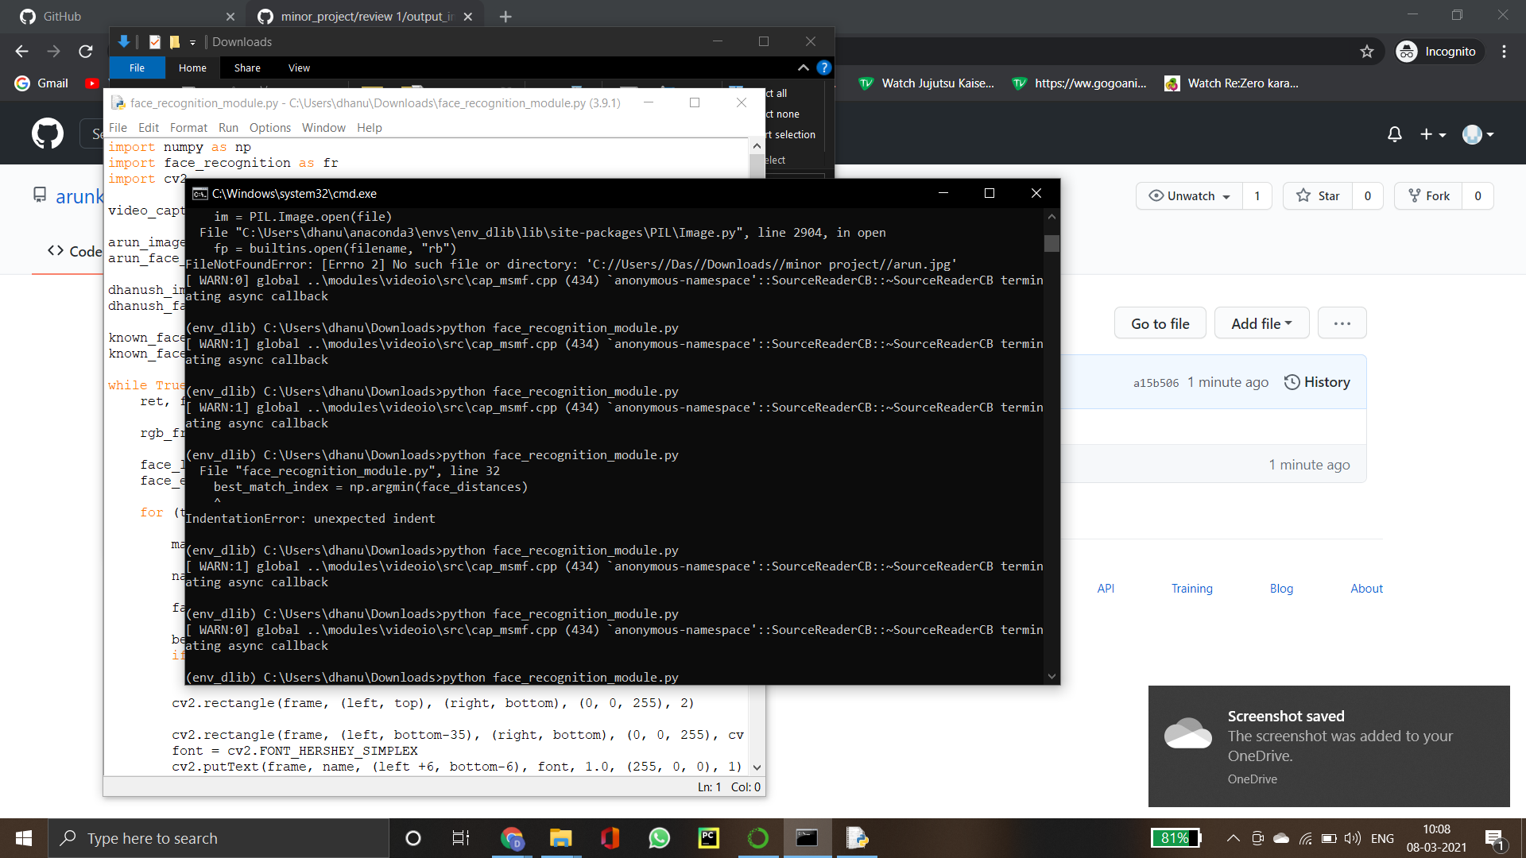
Step 2: Install the packages (cv2, dlib, face_recognition)

Slide 14

Step 1: Collection and setup of target images(criminals, missing people)
MODULE:2

Slide 15

Step 2: Code to collect the frames from web cam using cv2 and send to face_recognition module to recognize target . i. The target faces are loaded and encoded using face_recognition which uses MTCNN to compare faces using its default dataset. ii. Start webcam using cv2 iii. Now, for each frame from the webcam, it compares with the known target face. If match score is more than 50%, the known target name is placed under the face using cv2

Slide 16
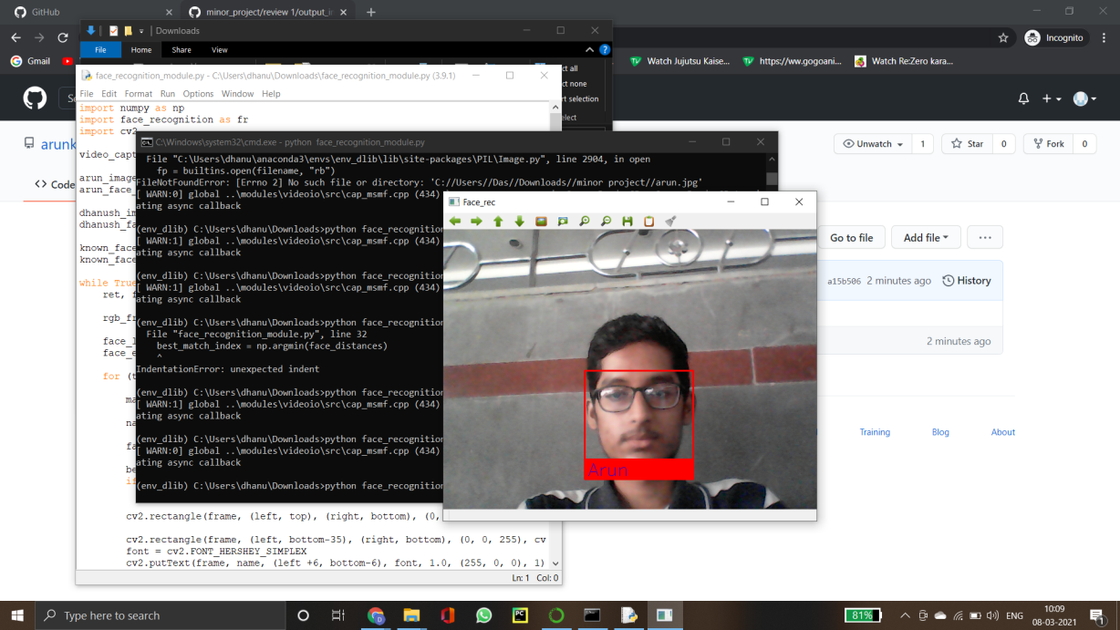
Step 3: Execution and output python face_recognition.py command is used to run the python code in the environment

Slide 17
Architecture Diagram
Data –Flow Diagram

Slide 18
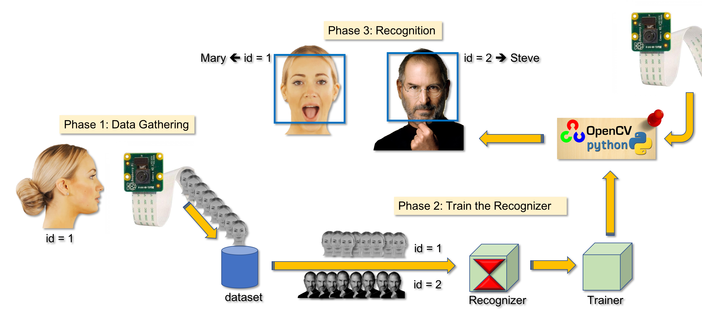
Camera Feed
Input: Target image
Web-App
Front End
Target image
Collection and
Retrieval of
Target Images
Name and location of identified target
Web-App
Back End
TEST THE OUTPU T
Cloud Storage
Alert is sent if
Face recognized
03-03-2021

Slide 19
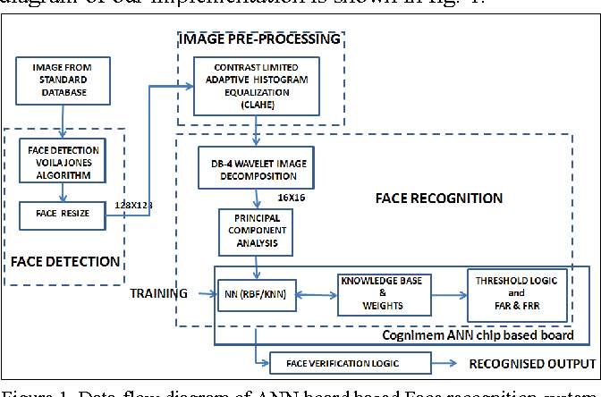
DATA FLOW DIAGRAM
TEST THE OUTPU T
03-03-2021

Slide 20

This project helps in detecting and tracking of faces which are present in the police database
There can be many details collected along with the location of user, such as vehicle number(if the user is in a vehicle), friend’s faces, assets such as ornaments, etc.
Moreover, this can be optimized enough to detect weapons and other illegal items through the public CCTVs

Slide 21
REFERENCES
Ayyappan, S., and S. Matilda. "Criminals And Missing Children Identification Using Face Recognition And Web Scrapping." In 2020 International Conference on System, Computation, Automation and Networking (ICSCAN), pp. 1-5. IEEE, 2020.
Son, Ngo Tung, Bui Ngoc Anh, Tran Quy Ban, Le Phuong Chi, Bui Dinh Chien, Duong Xuan Hoa, Le Van Thanh, Tran Quang Huy, Le Dinh Duy, and Muhammad Hassan Raza Khan. "Implementing cctv-based attendance taking support system using deep face recognition: A case study at fpt polytechnic college." Symmetry 12, no. 2 (2020): 307.
Jose, Edwin, M. Greeshma, Mithun TP Haridas, and M. H. Supriya. "Face recognition based surveillance system using facenet and mtcnn on jetson tx2." In 2019 5th International Conference on Advanced Computing & Communication Systems (ICACCS), pp. 608-613. IEEE, 2019.

Slide 22
REFERENCES
Shirsat, Samit, Aakash Naik, Darshan Tamse, Jaysingh Yadav, Pratiksha Shetgaonkar, and Shailendra Aswale. "Proposed System for Criminal Detection and Recognition on CCTV Data Using Cloud and Machine Learning." In 2019 International Conference on Vision Towards Emerging Trends in Communication and Networking (ViTECoN), pp. 1-6. IEEE, 2019.
Papaioannou, Savvas, Andrew Markham, and Niki Trigoni. "Tracking people in highly dynamic industrial environments." IEEE Transactions on mobile computing 16, no. 8 (2016): 2351-2365.
Yang, Min-Chun, Chia-Po Wei, Yi-Ren Yeh, and Yu-Chiang Frank Wang. "Recognition at a long distance: Very low resolution face recognition and hallucination." In 2015 International Conference on Biometrics (ICB), pp. 237-242. IEEE, 2015.

Slide 23
REFERENCES
Klontz, Joshua C., and Anil K. Jain. "A case study of automated face recognition: The boston marathon bombings suspects." Computer 46, no. 11 (2013): 91-94.
Wong, Yongkang, Shaokang Chen, Sandra Mau, Conrad Sanderson, and Brian C. Lovell. "Patch-based probabilistic image quality assessment for face selection and improved video-based face recognition." In CVPR 2011 WORKSHOPS, pp. 74-81. IEEE, 2011.
Jain, Anil K., Brendan Klare, and Unsang Park. "Face recognition: Some challenges in forensics." In 2011 IEEE International Conference on Automatic Face & Gesture Recognition (FG), pp. 726-733. IEEE, 2011.
Han, Mei, Amit Sethi, Wei Hua, and Yihong Gong. "A detection-based multiple object tracking method." In 2004 International Conference on Image Processing, 2004. ICIP'04., vol. 5, pp. 3065-3068. IEEE, 2004.

Slide 24
THANK YOU

